Slide 1
Java 4 WEB
Lesson 16 - Home Task Overview

Slide 2
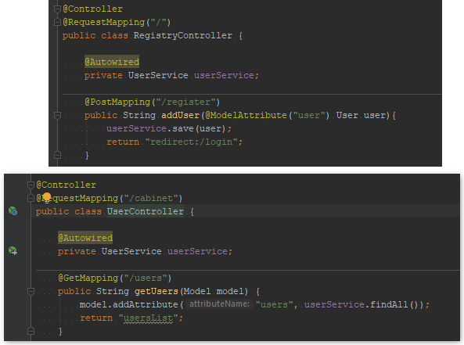
1. Use injection via constructor everywhere

Slide 3
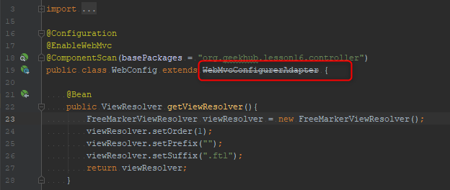
2. Do not extend deprecated classes

Slide 4
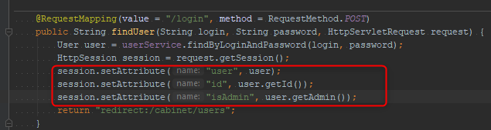
3. Do not store unused data in session

Slide 5
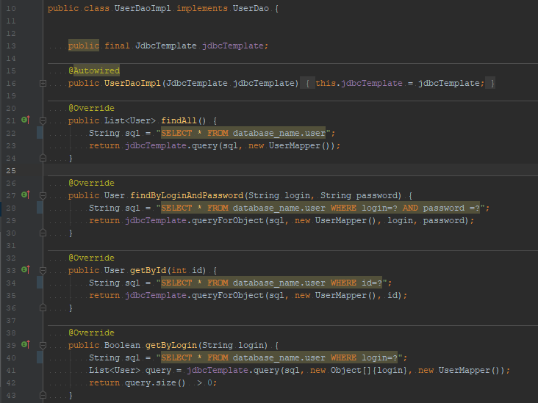
4. Database name should not be used anywhere in code

Slide 6
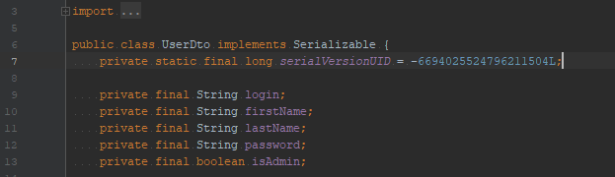
5. Type should not be serializable if you do not serialize it

Slide 7
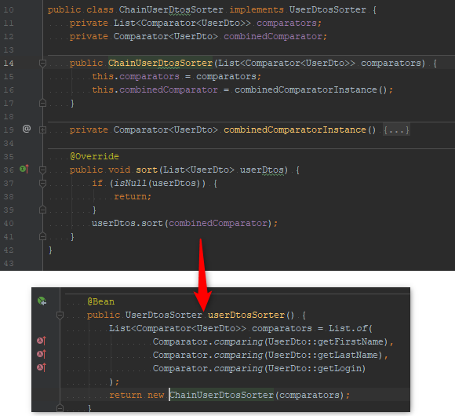
6. Do not make all classes components

Slide 8
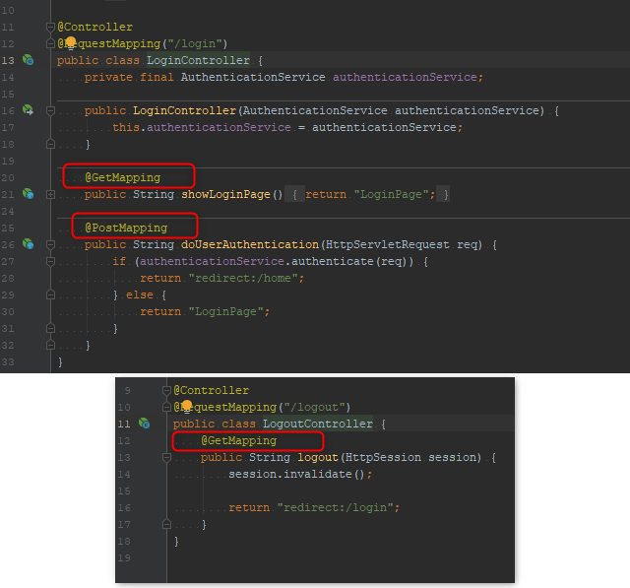
7. Do not use Get/Post/PutMapping annotations without value

Slide 9
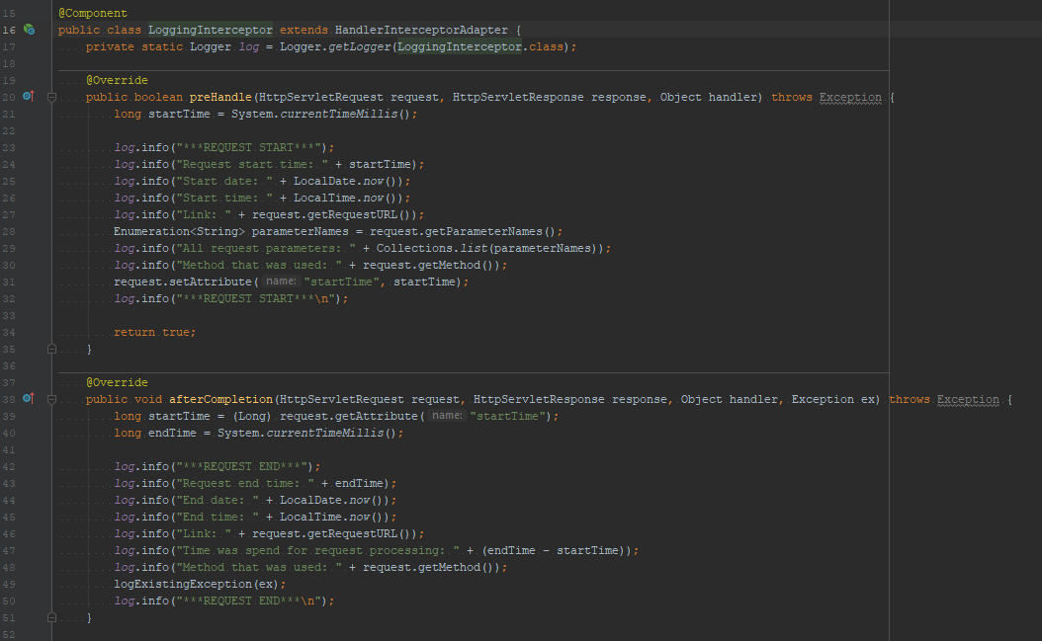
8. Do not use separated outputs

Slide 10
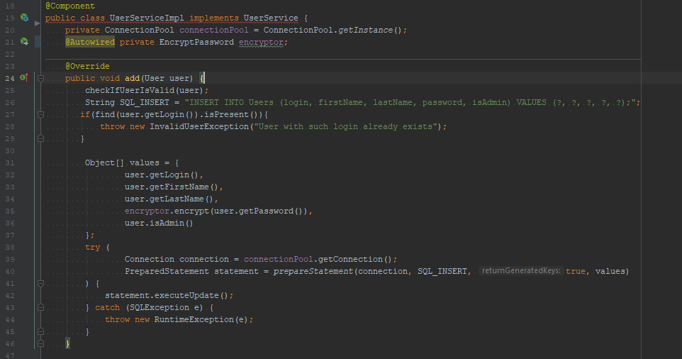
9. Move logic works with database into separate class - repository or dao

Slide 11
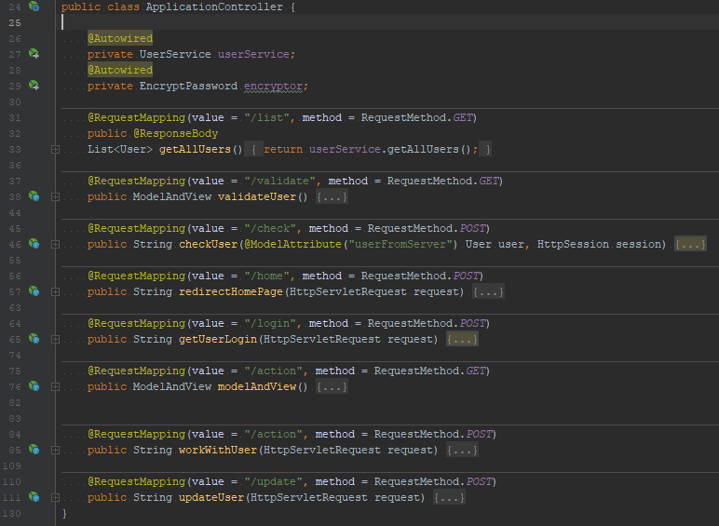
10. Do not implements all endpoints in one controller

Slide 12
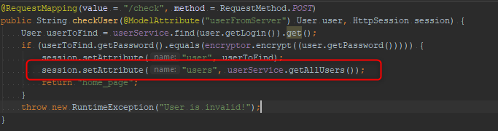
11. Do not store all users in session

Slide 13
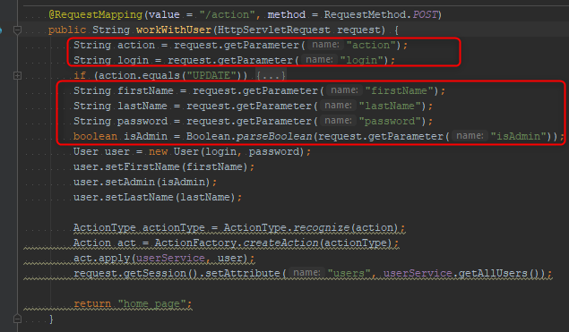
12. Use RequestParam, ModelAttribute, etc annotations

Slide 14
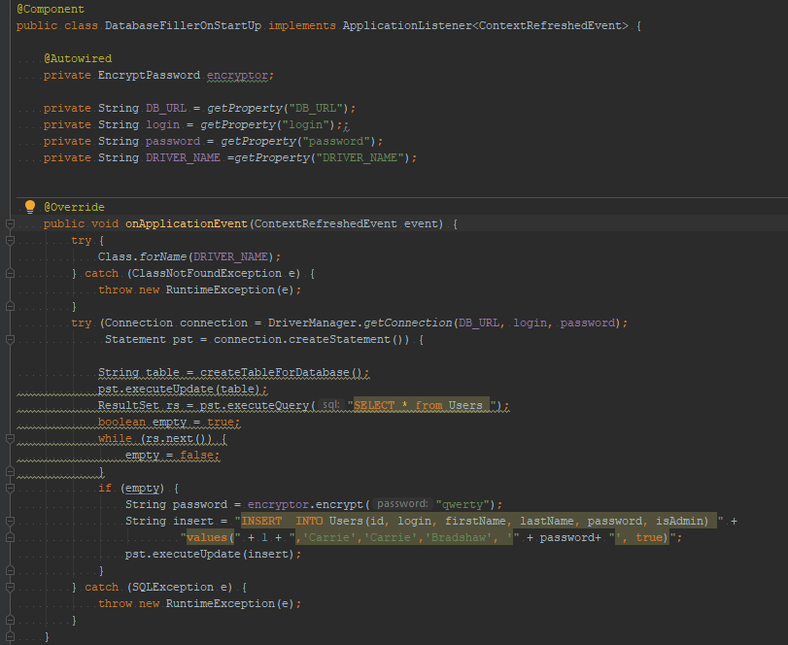
13. Use Spring DB populator mechanism

